Slide 1
ITU ML Report
Dhruv Kapur – University of Chicago class of 2026

Slide 2
Objective Function
Find a Machine Learning Process to accurately predict downlink or uplink
Criteria to be evaluated on:
Total data set features used
R^2 value
Generated report
Note that the dataset would be split by a target and source domain.
Eg. By operator, or by cars

Slide 3
Approach
Feature selection
Variables that affect downlink or uplink
Domain selection
Splitting of the data set
Algorithm analysis
Determining how effective the algorithm is
Report generation
Finalizing the algorithm and explaining feature and domain choices

Slide 4
Main data components
PCell
SCell
Variables led by “PCELL”
Primary data results for variables such as: RSRP, RSRQ, and SINR
Variables led by “SCELL”
Secondary data results for variables such as: RSRP, RSRQ, and SINR
Misc
Variables not included in PCELL or SCELL
Data results for variables such as: ping, altitude, speed

Slide 5
Feature selection
Select from the known
Choose features that are known to affect downlink data rates
Examine the affect – positive or negative – on the machine learning algorithm
Once a set of known variables has proven to increase efficacy of algorithm, start on:
Trial and error on the unknown
Choose variables that may not necessarily affect downlink data rate and using trial and error, cull the list to those that can help our algorithm

Slide 6
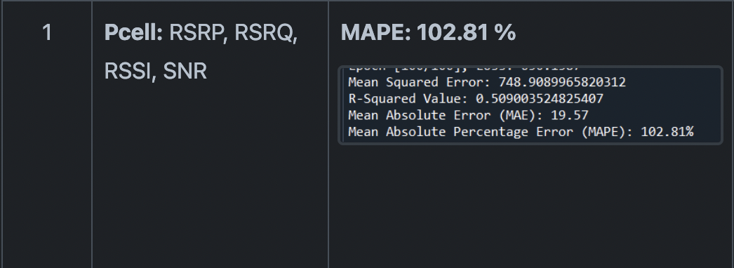
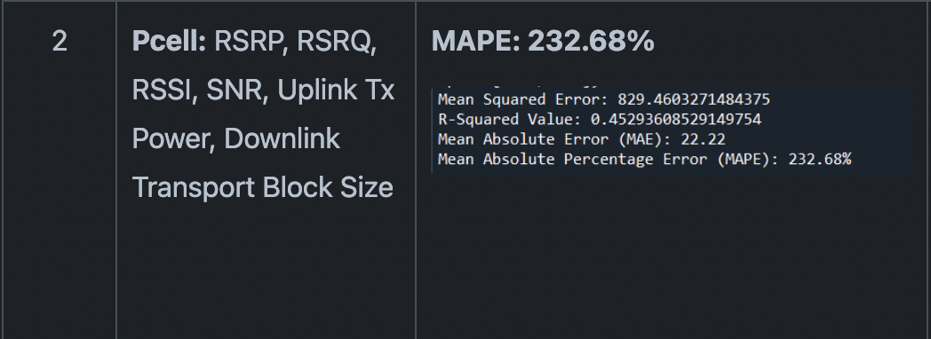
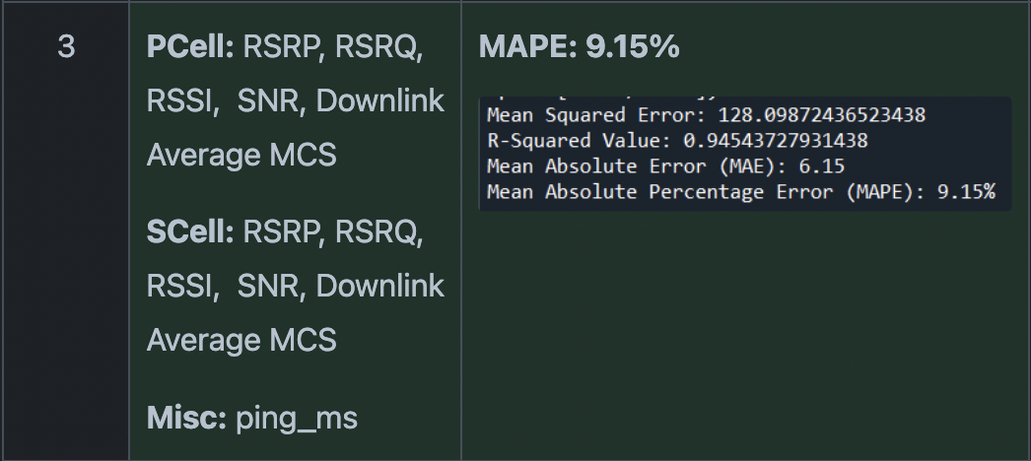
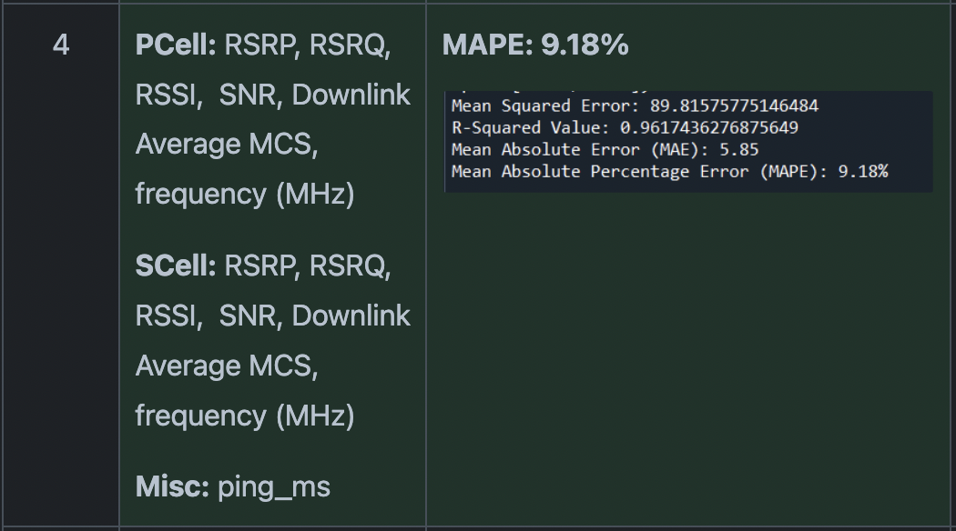
Example Feature selection

Slide 7
Feature selection
Unrelated Features
Now that a high r^2 value has been achieved, we will add “fluff” features to increase overall score
Different Models
Changing hidden network size and run time in artificial neural networks, or trying out different regression models
Different Train and Test Set Sizes
Different percentages of train/set set to see the effect it had on the algorithm
Strategy Specific Selection
Adding specific “fluff” features
Choosing features that had little to no negative effects on algorithm

Slide 8
Domains – Train and test sets
Park and Avenue
Operator 1 and Operator 2
Data collected around parks is used to predict downlink around avenues
Data collected by operator 1 is used to predict the downlink of operator 2
Uplink and Downlink
Highway and Residential
Data collected during uplink is used to predict downlink
Data collected on highways is used to predict downlink in residential areas

Slide 9
Finalizing algorithm
Park and avenue
Evaluating r^2
Future plans
It was determined through testing that the park and avenue domains were best for our algorithm
Possibly due to similar levels of interference or other factors
Sharp decrease in accuracy when switching train and test sets
Could be explained by the size of train and test sets changing
To improve the algorithm some steps may be taken such as:
Adding more features, training the algorithm longer, changing domain

Slide 10
THANK YOU
Dhruv Kapur
https://github.com/dkapur2026/ITU_AI_ML_CHALLENGE/tree/main
Dhruv.m.kapur@gmail.com

